Slide 1
A project Presentation on : ( Simon Game )
Under the Guidance of :
Prof. Priyanka Kaurav.
Presented by:
1. Pratiksha Jagannath Solat.
2. Supriya Bapu Sobale.
3. Sneha Singh.
Second year, Department of computer engineering

Slide 2
Presentation Outline: 1. Problem Statement 2. Motivation 3. Objectives 4. Methodology 5. Software and Hardware Requirement 6. Implementation 7. Conclusion 8. Reference

Slide 3
Problem Statement
The implementation of the Simon Game project involves the use of HTML for structuring the game elements, CSS for visually enhancing the interface, and JavaScript for implementing the game logic and interactivity. These technologies work together to create a seamless and enjoyable gaming experience for player.
The Simon Game is a classic electronic memory game that has been recreated in a web-based format using HTML, CSS, and JavaScript. The game is designed to test the player's memory skills and challenge their ability to follow and reproduce sequences.

Slide 4
Motivation
Though the Simon game project , players can enhance their cognitive abilities , including memory , attention , and pattern recognition.
The game provides immediate feedback , track the players score, and allows them to progress through higher level as they successfully complete each level.
Overall , the Simon game aims to deliver a fun and challenging gaming experience while showcasing the capabilities of web developing technologies.

Slide 5
Objective
The objective of the Simon game project is to learn and gain proficiency In front-end web development by creating this iconic game.
Through the development process, the project developer aims to enhance their skills in HTML, CSS, and JavaScript, with a focus on user interface design , event handling, game logic implementation, and overall web development.
By working on this project, the developer can acquire practical experience in front-end development and expand their knowledge in creating interactive and visually appealing web applications .
The secondary objective of the Simon Game is to engage in an interactive and enjoyable gaming experience while also improving focus and memory skills.
The game serve as a mean to enhance concentration , memory retention, and pattern recognition abilities for the end users.

Slide 6
Software and Hardware requirement
Software requirement:
Operating system : window 7 or later, macOs , or Linux
Web browser : Latest version of Popular web browser such as Google chrome, Mozilla Firefox, Safari, or Microsoft edge.
Hardware requirement:
Processor : Intel core i3 or equivalent.
RAM : 2GB or higher.
Storage : 100MB of free disk space

Slide 7
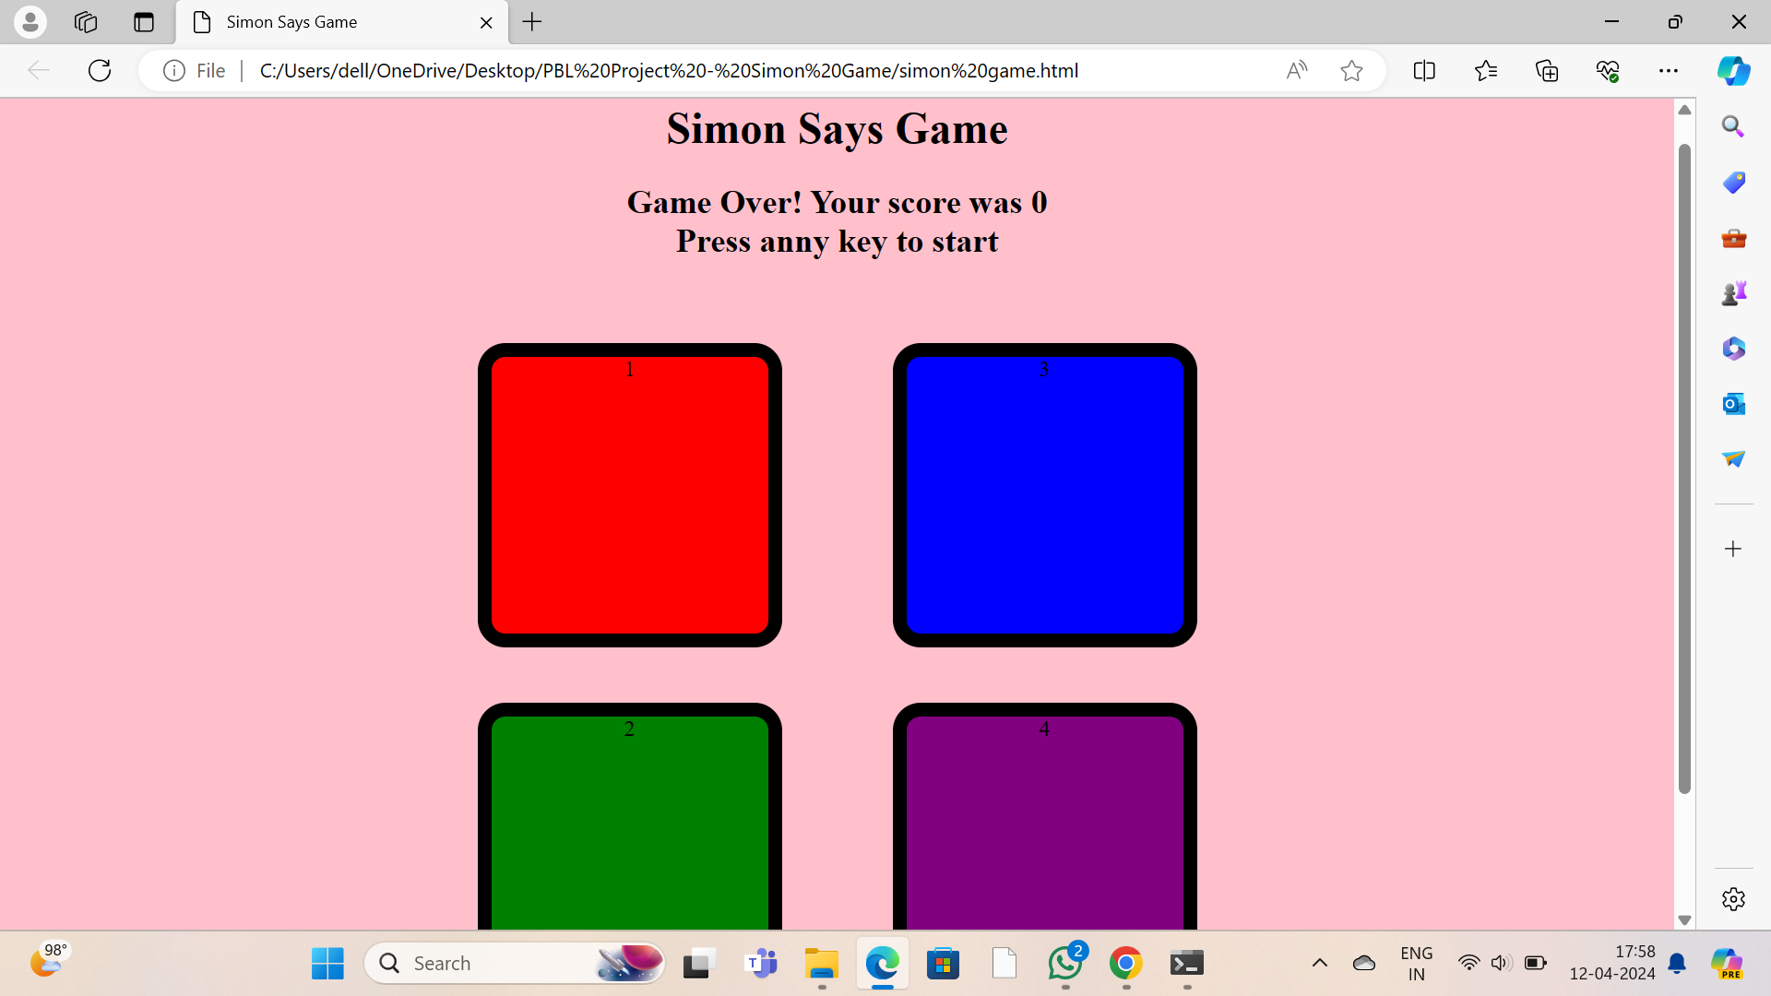
Implementation

Slide 8
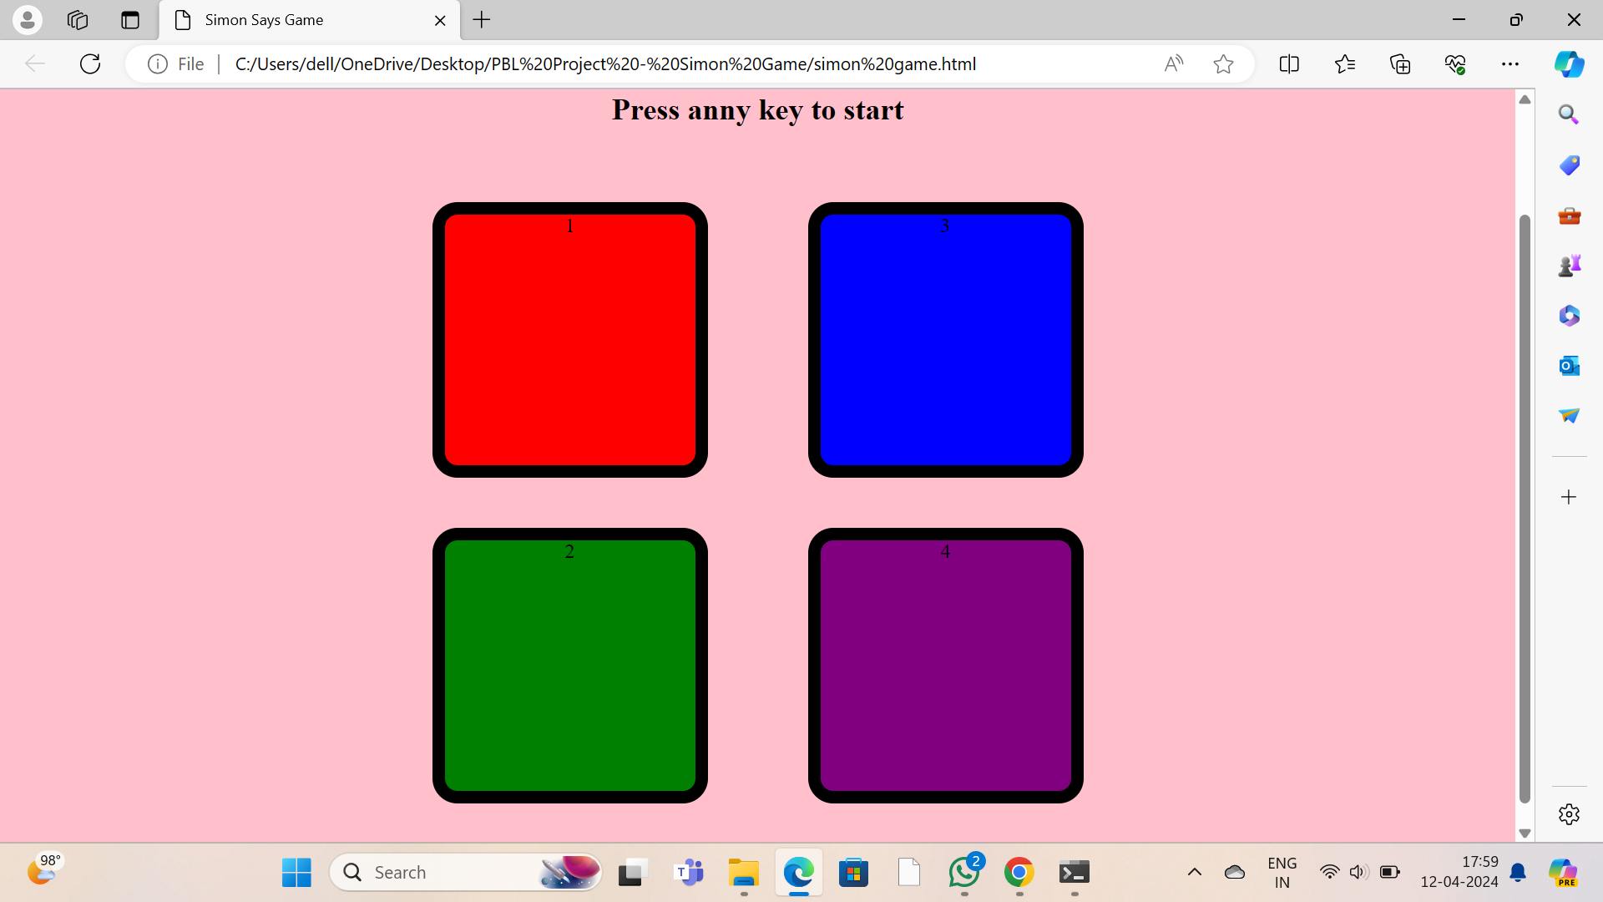

Slide 9
Conclusion
During testing, the Simon Game project demonstrated successful functionality and provided an engaging user experience. The game was able to generate and display sequences of colored buttons , track user input, update the score, and manage level progression effectively.
Players were able to interact with the game interface, follow the sequence of button flashes, and progress through levels by reproducing the sequence accurately .
The project was completed successfully, meeting the initial requirements and objectives. The game show cased the application of HTML, CSS, and JavaScript to create a visually appealing and interactive gaming experience.
The implementation of game logic , event handling and score management allowed for smooth gameplay and a sense of progression.

Slide 10
Reference
Various online documentation, articles, and forums were consulted during the development process to understand specific concepts, best practices, and problem-solving techniques.

